Slide 1
Software Architecture Modeling
An architectural modeling notation is a language or means of capturing
design decisions.
Notes Adapted from:
Software Architecture: Foundations, Theory, and Practice, Taylor et al.
Modeling and Simulating Software Architectures: The Palladio Approach, Reussner et al.

Slide 2
Objectives
Concepts
What is modeling?
How do we choose what to model?
What kinds of things do we model?
How can we characterize models?
How can we break up and organize models?
How can we evaluate models and modeling notations?
Examples
Concrete examples of many notations used to model software architectures
Introducing a Lunar Lander example as expressed in different modeling notations

Slide 3
What is Architectural Modeling?
Recall that we have characterized architecture as the set of principal design decisions made about a system
We can define models and modeling in those terms
An architectural model is an artifact that captures some or all of the design decisions that comprise a system’s architecture
Architectural modeling is the reification and documentation of those design decisions
How we model is strongly influenced by the notations we choose:
An architectural modeling notation is a language or means of capturing design decisions.

Slide 4
How do We Choose What to Model?
Architects and other stakeholders must make critical decisions:
What architectural decisions and concepts should be modeled,
At what level of detail, and
With how much rigor or formality
These are cost/benefit decisions
The benefits of creating and maintaining an architectural model must exceed the cost of doing so

Slide 5
Stakeholder-Driven Modeling
Stakeholders identify aspects of the system they are concerned about
Stakeholders decide the relative importance of these concerns
Modeling depth should roughly mirror the relative importance of concerns
From Maier and Rechtin, “The Art of Systems Architecting” (2000)

Slide 6
The Lunar Lander Example – Taken from Taylor’s Book
A simple computer game that first appeared in the 1960’s
Simple concept:
You (the pilot) control the descent rate of the Apollo-era Lunar Lander
Throttle setting controls descent engine
Limited fuel
Initial altitude and speed preset
If you land with a descent rate of < 5 fps: you win (whether there’s fuel left or not)
“Advanced” version: joystick controls attitude & horizontal motion

Slide 7

What do We Model?
Basic architectural elements
Components
Connectors
Interfaces
Configurations
Rationale – reasoning behind decisions

Slide 8
What do We Model? (cont’d)
Elements of the architectural style
Inclusion of specific basic elements
Components, connectors, interfaces
Component, connector, and interface types
Constraints on interactions
Only components in a particular layer may call operators in another layer.
Particular protocols like HTTP, FTP.
Behavioral constraints
Rules or specifications limiting behavior
Concurrency constraints
Which elements perform their functions concurrently and how do they synchronize.

Slide 9
What do We Model? (cont’d)
Static and Dynamic Aspects
Static aspects of a system do not change as a system runs
e.g., topologies, assignment of components/connectors to hosts, …
Dynamic aspects do change as a system runs
e.g., State of individual components or connectors, state of a data flow through a system, …
The static/dynamic interaction is often unclear
Consider a system whose topology is relatively stable but changes due to component failure.

Slide 10
What do We Model? (cont’d)
Functional and non-functional aspects of a system
Functional
“The system prints medical records”
Non-functional
“The system prints medical records quickly and confidentially.”
Architectural models tend to be functional, but like rationale it is often important to capture non-functional decisions even if they cannot be automatically or deterministically interpreted or analyzed

Slide 11
Views and Viewpoints

Slide 12
Views and Viewpoints
Generally, it is not feasible to capture everything we want to model in a single model or document
The model would be too big, complex, and confusing
So, we create several coordinated models, each capturing a subset of the design decisions
Generally, the subset is organized around a particular concern or other selection criteria
We call the subset-model a ‘view’ and the concern (or criteria) a ‘viewpoint’

Slide 13
Views and Viewpoints Example
Deployment view of a 3-tier application
Deployment view of a Lunar Lander system
Both instances of the deployment viewpoint

Slide 14
Commonly-Used Viewpoints
Logical Viewpoints
Capture the logical (often software) entities in a system and how they are interconnected.
Physical Viewpoints
Capture the physical (often hardware) entities in a system and how they are interconnected.
Deployment Viewpoints
Capture how logical entities are mapped onto physical entities.

Slide 15
Commonly-Used Viewpoints (cont’d)
Concurrency Viewpoints
Capture how concurrency and threading will be managed in a system.
Behavioral Viewpoints
Capture the expected behavior of (parts of) a system.

Slide 16
Consistency Among Views
Views can contain overlapping and related design decisions
There is the possibility that the views can thus become inconsistent with one another
Views are consistent if the design decisions they contain are compatible
Views are inconsistent if two views assert design decisions that cannot simultaneously be true
Inconsistency is usually but not always indicative of problems
Temporary inconsistencies are a natural part of exploratory design
Inconsistencies cannot always be fixed

Slide 17
Example of View Inconsistency

Slide 18
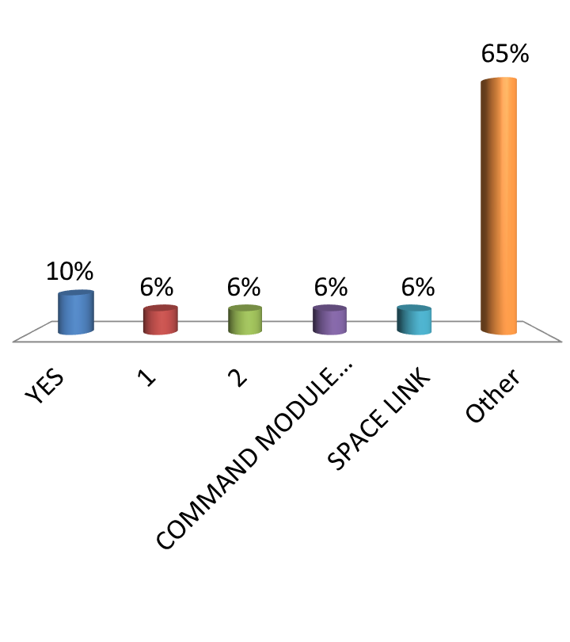
What is inconsistent in the prior two models?
Rank | Responses
1 | YES
2 | 1
3 | 2
4 | COMMAND MODU...
5 | SPACE LINK
6 | Other

Slide 19
Common Types of Inconsistencies
Direct inconsistencies
E.g., “The system runs on two hosts” and “the system runs on three hosts.”
Refinement inconsistencies
High-level (more abstract) and low-level (more concrete) views of the same parts of a system conflict
Static vs. dynamic aspect inconsistencies
Dynamic aspects (e.g., behavioral specifications) conflict with static aspects (e.g., topologies)
An component in a sequence diagram does not exist in the component diagram.

Slide 20
Common Types of Inconsistencies (cont’d)
Dynamic vs. dynamic aspect inconsistencies
Different descriptions of dynamic aspects of a system conflict.
An interaction in the sequence diagram Is not allowed in a state diagram.
This example tries to combine state into the sequence diagram as a way to be compatible with the state diagram of the control panel.
Note: This notation does nto conform to any standard so it is up to interpretation.

Slide 21
Common Types of Inconsistencies (cont’d)
Functional vs. non-functional inconsistencies
A non-functional requirement might state that the system has to be robust but the deployment shows that only 1 server is being utilized.

Slide 22
Evaluating Modeling Approaches

Slide 23
Evaluating Modeling Approaches
Scope and purpose
What does the technique help you model? What does it not help you model?
Basic elements
What are the basic elements (the ‘atoms’) that are modeled? How are they modeled?
Style
To what extent does the approach help you model elements of the underlying architectural style? Is the technique bound to one particular style or family of styles?

Slide 24
Evaluating Modeling Approaches (cont’d)
Static and dynamic aspects
What static and dynamic aspects of an architecture does the approach help you model?
Dynamic modeling
To what extent does the approach support models that change as the system executes?
Non-functional aspects
To what extent does the approach support (explicit) modeling of non-functional aspects of architecture?

Slide 25
Evaluating Modeling Approaches (cont’d)
Ambiguity
How does the approach help you to avoid (or embrace) ambiguity?
Accuracy
How does the approach help you to assess the correctness of models?
Precision
At what level of detail can various aspects of the architecture be modeled?

Slide 26
Evaluating Modeling Approaches (cont’d)
Viewpoints
Which viewpoints are supported by the approach?
Viewpoint Consistency
How does the approach help you assess or maintain consistency among different viewpoints?

Slide 27
Modeling Approaches

Slide 28
Surveying Modeling Approaches
Generic approaches
Natural language
PowerPoint-style modeling
UML, the Unified Modeling Language
Early architecture description languages
Darwin
Rapide
Wright
Domain- and style-specific languages
Koala
Weaves
AADL
Extensible architecture description languages
Acme
ADML
xADL

Slide 29
Surveying Modeling Approaches (cont’d)
Generic approaches
Natural language
PowerPoint-style modeling
UML, the Unified Modeling Language
Early architecture description languages
Darwin
Rapide
Wright
Domain- and style-specific languages
Koala
Weaves
AADL
Extensible architecture description languages
Acme
ADML
xADL

Slide 30
Natural Language
Spoken/written languages such as English
Advantages
Highly expressive
Accessible to all stakeholders
Good for capturing non-rigorous or informal architectural elements like rationale and non-functional requirements
Plentiful tools available (word processors and other text editors)
Disadvantages
Ambiguous, non-rigorous, non-formal
Often verbose
Cannot be effectively processed or analyzed by machines/software

Slide 31
Natural Language Example
“The Lunar Lander application consists of three components: a data store component, a calculation component, and a user interface component.
The job of the data store component is to store and allow other components access to the height, velocity, and fuel of the lander, as well as the current simulator time.
The job of the calculation component is to, upon receipt of a burn-rate quantity, retrieve current values of height, velocity, and fuel from the data store component, update them with respect to the input burn-rate, and store the new values back. It also retrieves, increments, and stores back the simulator time. It is also responsible for notifying the calling component of whether the simulator has terminated, and with what state (landed safely, crashed, and so on).
The job of the user interface component is to display the current status of the lander using information from both the calculation and the data store components. While the simulator is running, it retrieves the new burn-rate value from the user, and invokes the calculation component.”

Slide 32
Related Alternatives
Ambiguity can be reduced and rigor can be increased through the use of techniques like ‘statement templates,’ e.g.:
The (name) interface on (name) component takes (list-of-elements) as input and produces (list-of-elements) as output (synchronously | asynchronously).
This can help to make rigorous data easier to read and interpret, but such information is generally better represented in a more compact format

Slide 33
Natural Language Evaluation
Scope and purpose
Capture design decisions in prose form
Basic elements
Any concepts required
Style
Can be described by using more general language
Static & Dynamic Aspects
Any aspect can be modeled
Dynamic Models
No direct tie to implemented/ running system
Non-Functional Aspects
Expressive vocabulary available (but no way to verify)
Ambiguity
Plain natural language tends to be ambiguous; statement templates and dictionaries help
Accuracy
Manual reviews and inspection
Precision
Can add text to describe any level of detail
Viewpoints
Any viewpoint (but no specific support for any particular viewpoint)
Viewpoint consistency
Manual reviews and inspection

Slide 34
In-class Exercises
Do in-class exercises 2a and 2b.

Slide 35
Informal Graphical Modeling
General diagrams produced in tools like PowerPoint and Visio
This is what I refer to as “Box and Line” drawings.
Advantages
Can be aesthetically pleasing
Size limitations (e.g., one slide, one page) generally constrain complexity of diagrams
Extremely flexible due to large symbolic vocabulary
Disadvantages
Ambiguous, non-rigorous, non-formal
But often treated otherwise
Cannot be effectively processed or analyzed by machines/software

Slide 36
Informal Graphical Model Example

Slide 37
Related Alternatives
Some diagram editors (e.g., Microsoft Visio) can be extended with semantics through scripts and other additional programming
Generally ends up somewhere in between a custom notation-specific editor and a generic diagram editor
Limited by extensibility of the tool
PowerPoint Design Editor (Goldman, Balzer) was an interesting project that attempted to integrate semantics into PowerPoint

Slide 38
Informal Graphical Evaluation
Scope and purpose
Arbitrary diagrams consisting of symbols and text
Basic elements
Geometric shapes, splines, clip-art, text segments
Style
In general, no support
Static & Dynamic Aspects
Any aspect can be modeled, but no semantics behind models
Dynamic Models
Rare, although APIs to manipulate graphics exist
Non-Functional Aspects
With natural language annotations
Ambiguity
Can be reduced through use of rigorous symbolic vocabulary/dictionaries
Accuracy
Manual reviews and inspection
Precision
Up to modeler; generally canvas is limited in size (e.g., one ‘slide’)
Viewpoints
Any viewpoint (but no specific support for any particular viewpoint)
Viewpoint consistency
Manual reviews and inspection

Slide 39
UML – the Unified Modeling Language
Thirteen loosely-interconnected notations called diagrams that capture static and dynamic aspects of software-intensive systems
Advantages
Support for a diverse array of viewpoints focused on many common software engineering concerns
Ubiquity improves comprehensibility
Extensive documentation and tool support from many vendors
Disadvantages
Needs customization through profiles to reduce ambiguity
Difficult to assess consistency among views
Difficult to capture foreign concepts or views

Slide 40
UML Component Models

Slide 41
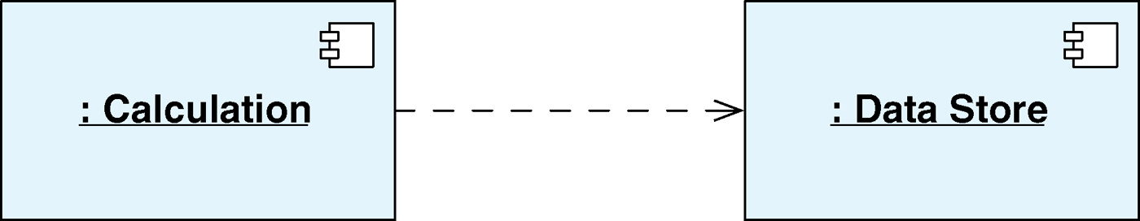
UML Component Diagram
The dashed arrow indicates that the Calculation component is dependent on the DataStore component. However, this could mean any number of things, including:
Some element of Calculation calls DataStore.
Instances of Calculation contain a pointer or reference to an instance of DataStore.
Calculation requires DataStore to compile.
Calculation’s implementation has a method that takes an instance of DataStore’s Implementation as a parameter.
Calculation can send messages to DataStore.

Slide 42
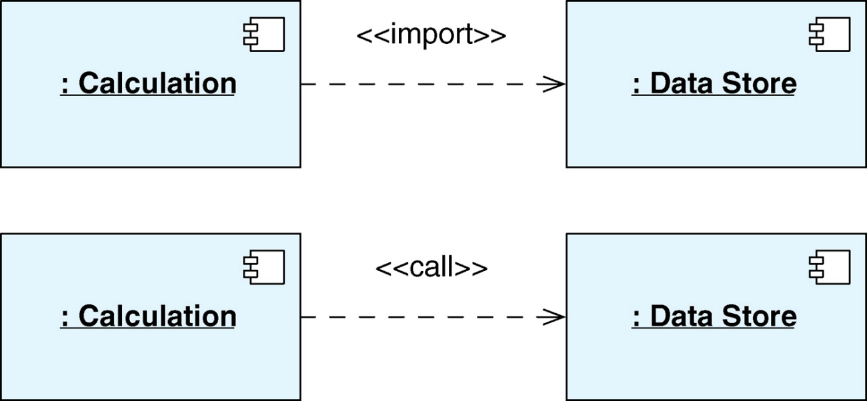
UML Stereotypes
Stereotypes or profiles in UML help minimize the semantic ambiguity by defining meaning.

Slide 43
UML Component Interfaces
Ball and Socket Notation
Ball is required
Socket is provided

Slide 44
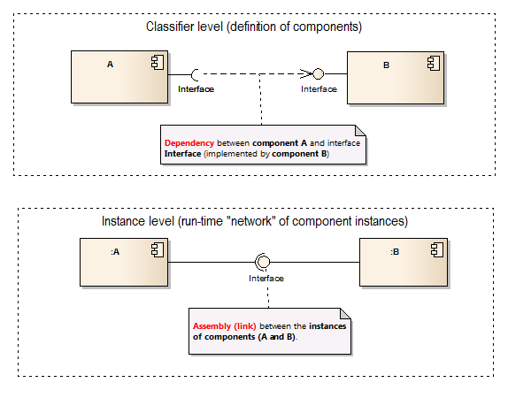
UML Component Interface Types
Top Diagram: Dependency between components exist on the definition level
Bottom Diagram: Assembly is a relationship established in run-time between two instances of a classifier.

Slide 45
UML Component Ports
Ports describe how a component interacts with its environment, similar to interfaces, but is different in that each port is a distinct interaction point of the component.
Each port can be associated with a number of interfaces, provided and/or required, in whatever collection makes sense for the point of interaction.

Slide 46
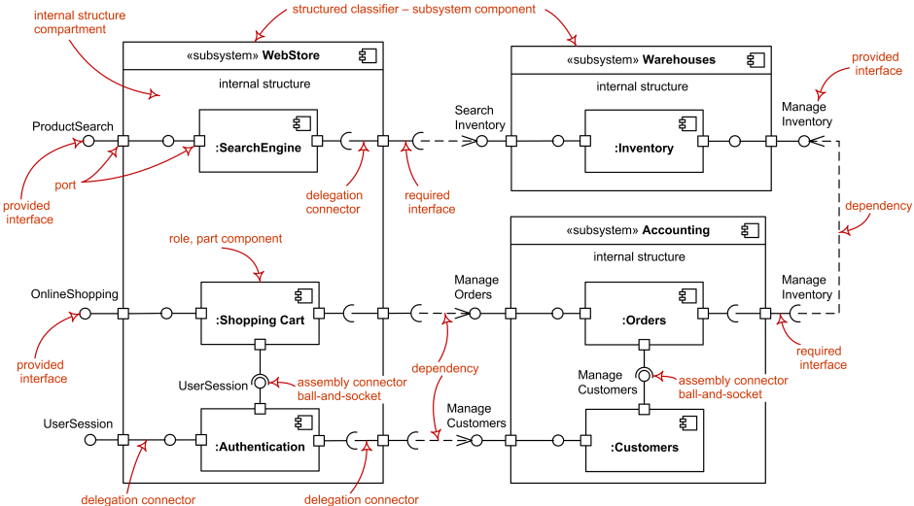
UML Component Example

Slide 47
Specifying Connector Types in the UML Component Models
Connectors in the UML Component models mostly capture Interface specifications and not connector types as we have seen in Taylor’s notation.
With the use of stereotypes it possible to specify connector types.

Slide 48
Point of sale (POS) Example
In this POS Example components are represented as “active objects” and the links are labelled with protocol or behavior information.
Even with this diagram it is necessary to define the semantics of the links and components with a textual description.

Slide 49
POS Component Description
Barcode Scanner: Responsible for 1) Control and communication with bar code scanner hardware and 2) notification providing ID of scanned bar code for items passing the scanner.
Sales: Responsible for 1) keeping track of items scanned; their price and quantity; running total of scanned items and 2) initiation and end of sales handling.
Presentation: Responsible for 1) displaying item names, quantity, subtotals and grand total on a terminal 2) printing item, quantity, subtotals and grand total on paper receipt 3) handle key board input for defining quantities when only one of a set of items are scanned.
Inventory: Responsible for 1) keeping track of items in store 2) mapping between bar code ID's and item name and unit price.

Slide 50
POS Connector Description
MVC: A standard MVC patterns is the protocol for this connector that connects the Sales component serving the role of model and Presentation serving as controller and view.
JDBC: This connector handles standard SQL queries over the JDBC protocol.
BSCP: This connector defines a protocol for connecting with a barcode scanner. Data and control is exchanged using ASCII strings in a coded format containing control words and data elements.

Slide 51
UML Deployment Model

Slide 52
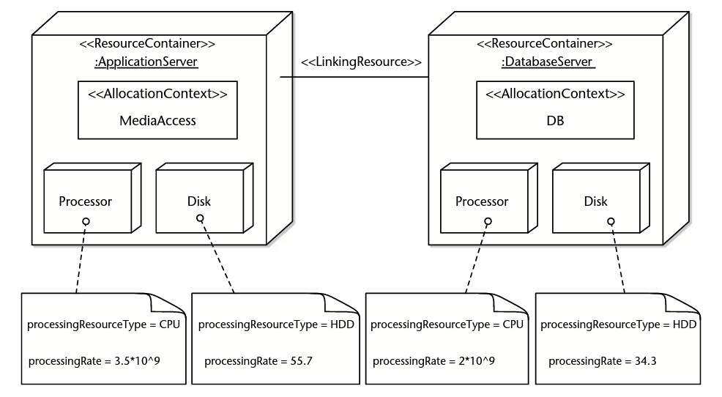
The UML Deployment Model
Captures the specification of the execution environment and the allocation of software components on resources of this execution environment.

Slide 53
POS Deployment Example also specifying connector types
Note how in this example stereotypes are used to specify the protocols between the deployment containers.
So this is another way that the UML captures connector types.

Slide 54
UML Sequence Diagrams

Slide 55
UML Sequence Diagrams
You should be fairly familiar with the semantics of this diagram, the key points from an architectural perspective is that ….
It will capture typical use cases as well as critical failure scenarios.
Captures interactions among the major components.
In the architectural design we are interested in what the software elements require (e.g., processing power, memory availability, network bandwidth) and what the hardware elements provide.

Slide 56
POS Example
This example focuses on the event of a single item being scanned and Registered
It uses objects rather than components.

Slide 57
Lunar Lander Example

Slide 58
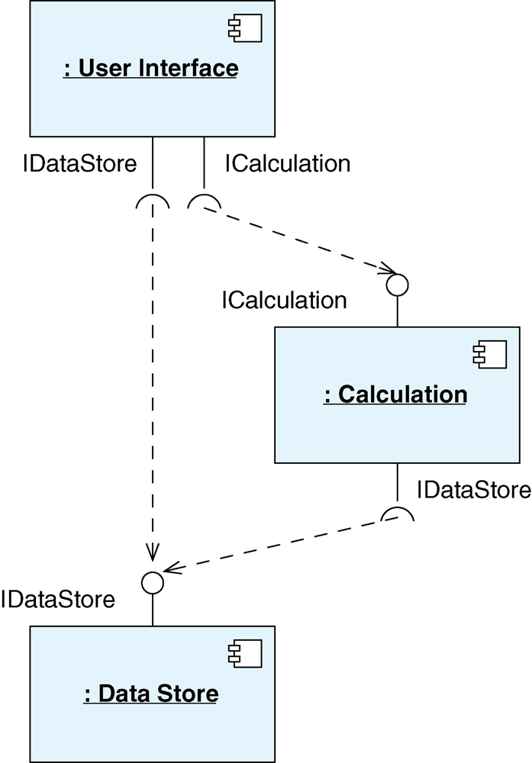
UML Lunar Lander Example
Component diagram
The diagram is trying to show that there is dependency between the modules through the need and provision of interfaces.

Slide 59
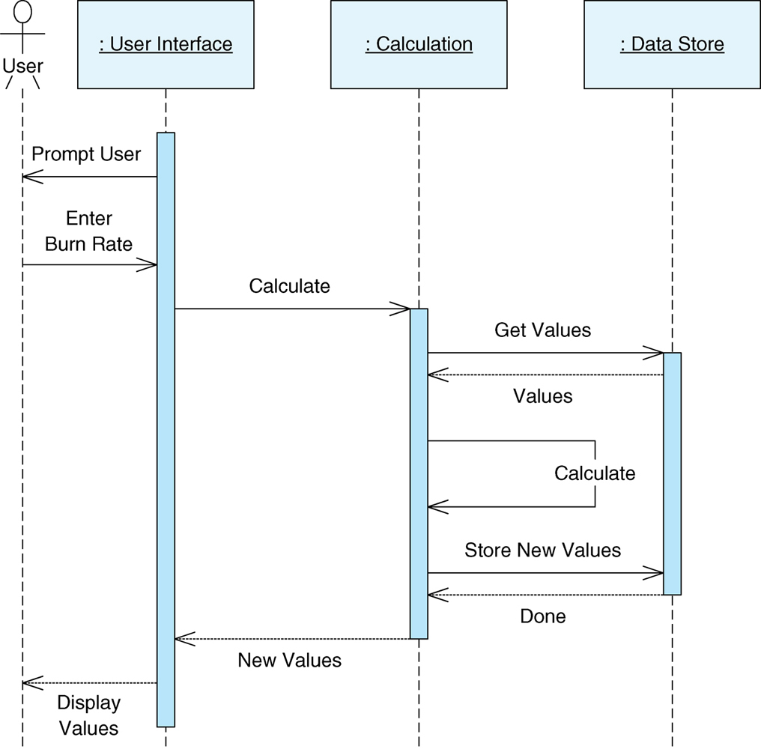
UML Lunar Lander Example
Sequence diagram
The diagram captures the interaction between the components in the system.

Slide 60
UML Evaluation
Ambiguity
Many symbols are interpreted differently depending on context; profiles reduce ambiguity
Accuracy
Well-formedness checks, automatic constraint checking, ersatz tool methods, manual
Precision
Up to modeler; wide flexibility
Viewpoints
Each diagram type represents a viewpoint; more can be added through overloading/profiles
Viewpoint consistency
Constraint checking, manual
Scope and purpose
Diverse array of design decisions in 13 viewpoints
Basic elements
Multitude – states, classes, objects, composite nodes…
Style
Through (OCL) constraints
Static & Dynamic Aspects
Some static diagrams (class, package), some dynamic (state, activity)
Dynamic Models
Rare; depends on the environment
Non-Functional Aspects
No direct support; natural-language annotations

Slide 61
Class Exercise
At this point a good exercise is to go back to the Cash Register requirements and construct a suitable UML component model.
Start of with dependency connections rather than interfaces at this point.

